Slide 1
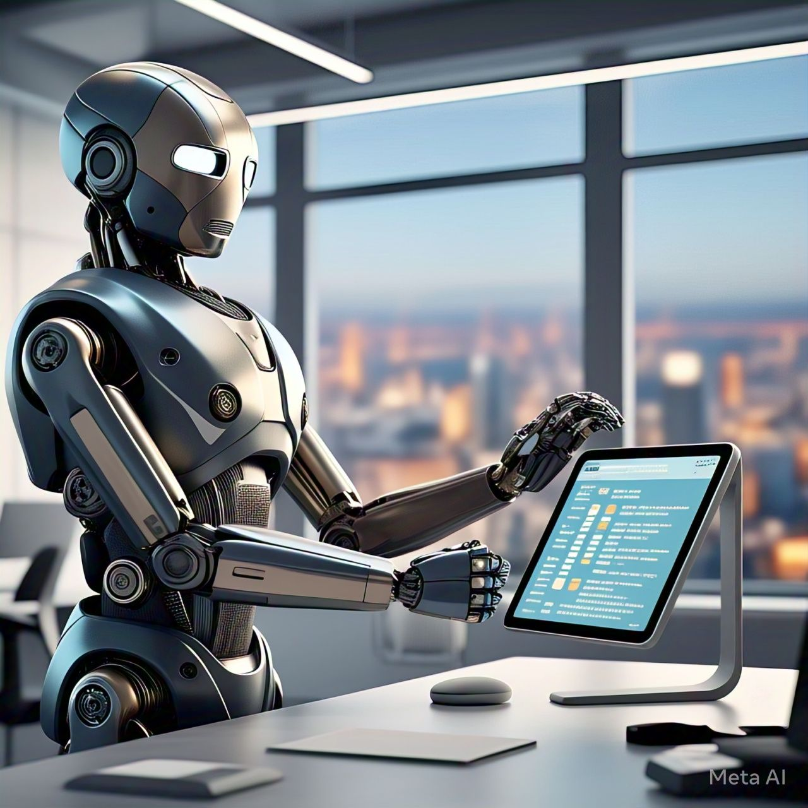
AI-Powered Scheduling Bot
Streamlining Interview Coordination for High-Volume Hiring
By Nikith Chowdary

Slide 2
Agenda
Introduction
Problem Statement
Goal
Solution
Key Features
Technical Architecture
Benefits
Conclusion

Slide 3
Problem Statement
Key Challenges:
Scheduling conflicts
Manual coordination
Candidate drop-off
Recruiter workload
Coordinating interviews for high-volume hiring is inefficient and time-consuming, leading to delays and lost candidates

Slide 4

Goal
To find a solution that can streamline the interview coordination process, reducing delays, and lost candidates, while also improving the overall efficiency and effectiveness of the hiring process.

Slide 5
Solution: Introducing the AI Interview Scheduling Bot
Automates interview coordination using AI and machine learning
Integrates with calendar systems and HR software
Provides real-time scheduling and reminders

Slide 6
Key Features
Smart scheduling: natural language understanding for scheduling requests
Calendar integration: seamless integration with Google Calendar and other calendar systems
User experience: modern, intuitive chat interface and mobile-responsive design
AI capabilities: context-aware conversations and learning from scheduling patterns

Slide 7

Technical Architecture of the AI Interview Scheduling Bot
Frontend layer: modern Streamlit-based UI and real-time WebSocket communication
Business logic layer: core NLP and scheduling logic, calendar operations, and helper functions
AI/ML pipeline: intent classification, time slot prediction, and context management system
Data storage: model artifacts, configuration management, caching system, and logging framework

Slide 8
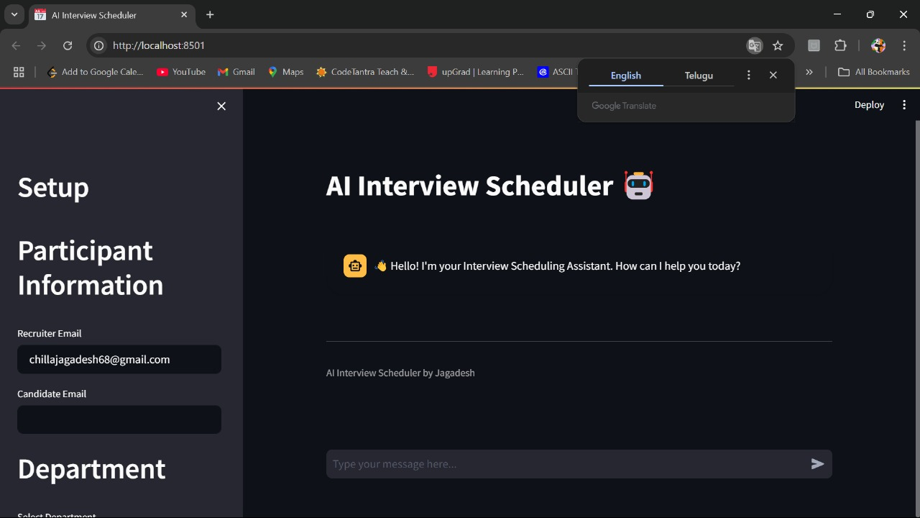
BOT Image

Slide 9
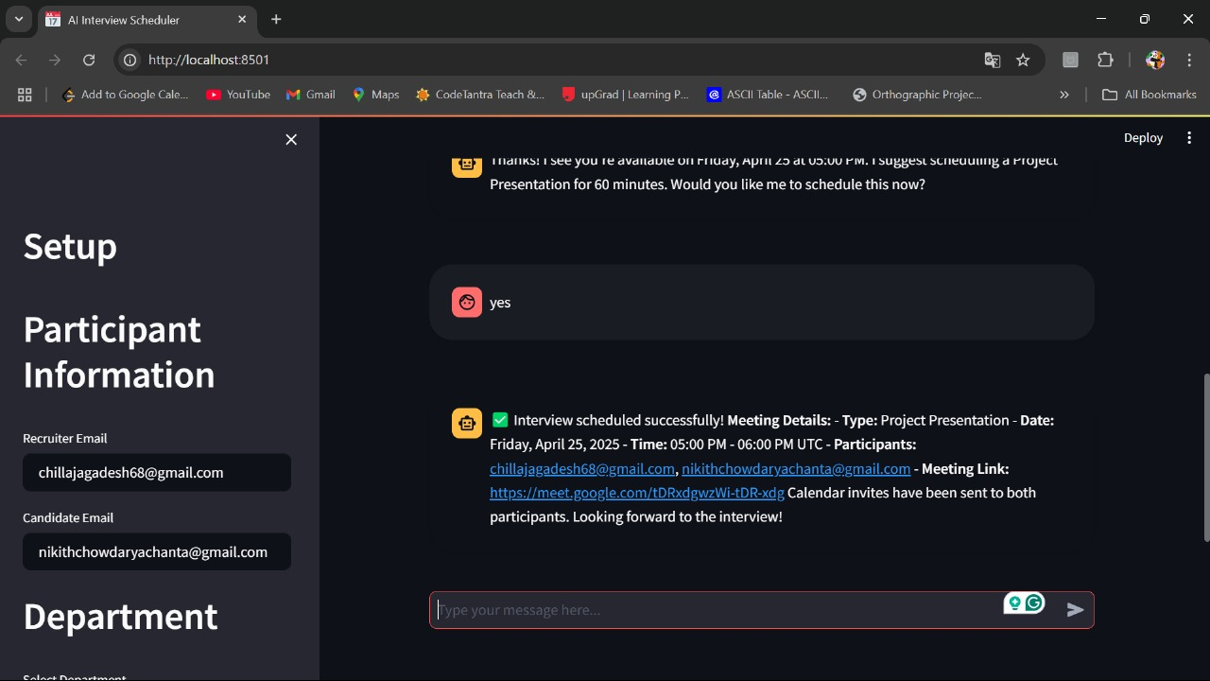
BOT Image

Slide 10
Future Roadmap of the AI Interview Scheduling Bot
Short-term goals: Microsoft Teams/Zoom integration, mobile application development, and enhanced analytics dashboard
Medium-term goals: multi-participant scheduling optimization, advanced NLP capabilities, and AI-powered meeting summarization
Long-term goals: blockchain-based scheduling verification, AR/VR meeting space integration, and custom hardware support

Slide 11
Benefits and ROI of the AI Interview Scheduling Bot
Reduced time-to-hire: automated scheduling and real-time reminders
Improved candidate experience: modern, intuitive chat interface and mobile-responsive design
Increased recruiter productivity: automated scheduling and reduced manual errors
Cost savings: reduced time and resources spent on manual scheduling

Slide 12
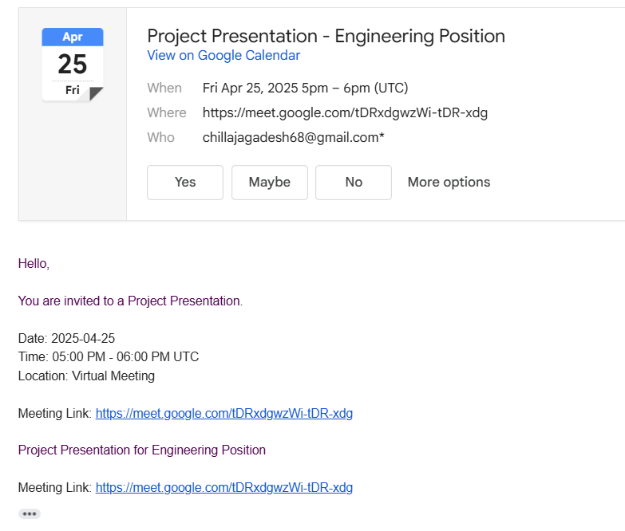
Conclusion
This is how the bot send mail to the selected candidate

Slide 13
Thank you
Questions?

